Slide 1

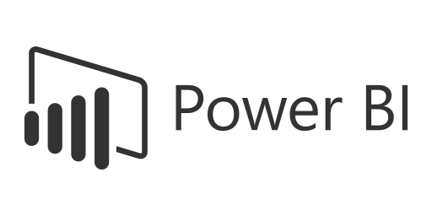



STOCK MARKET ANALYTICS

Slide 2
GROUP 1
TAMAL ROY
SUBHANKAR SADHU
ROHIT PATIL
RINA GAJGHATE
NILAM GOURAJE

Slide 3
PROJECT SUMMARY
This project presents a comprehensive Stock Market Analytics and Visualization System built using Excel, SQL, Power BI, and Tableau.
It integrates multi-source financial data to analyse market performance, volatility, sector growth, portfolio valuation, and trader efficiency.
A robust data model was developed by linking key datasets — including daily prices, positions, trades, orders, companies, sectors, and calendars — ensuring clean, accurate, and scalable relationships.
Using advanced SQL queries for data extraction and Excel preprocessing for cleansing, the data was visualized in Power BI and Tableau through interactive dashboards that deliver real-time market insights.
This end-to-end analytical framework empowers investors, analysts, and portfolio managers to make data-driven investment decisions, identify top-performing sectors, and monitor portfolio performance with precision.

Slide 4
KPI’s & METRICS
TOTAL MARKET CAPITALISATION : Total portfolio or market value.
AVERAGE DAILY TRADING VOL : Mean of daily volume traded
VOLATILITY : Price fluctuation measure
TOTAL NUMBER OF TRADES : Total Trades
TOP PERFORMING SECTOR : Sector with highest average return
PORTFOLIO VALUE : Total current market value of all holdings.
PORTFOLIO RETURN : % growth of portfolio value over time.
DIVIDEND YIELD : Income return generated through dividends
TRADE WIN RATE : % of profitable trades out of total executed trades.
TRADER PERFORMANCE (P/L) : Net profit or loss achieved by traders.

Slide 5
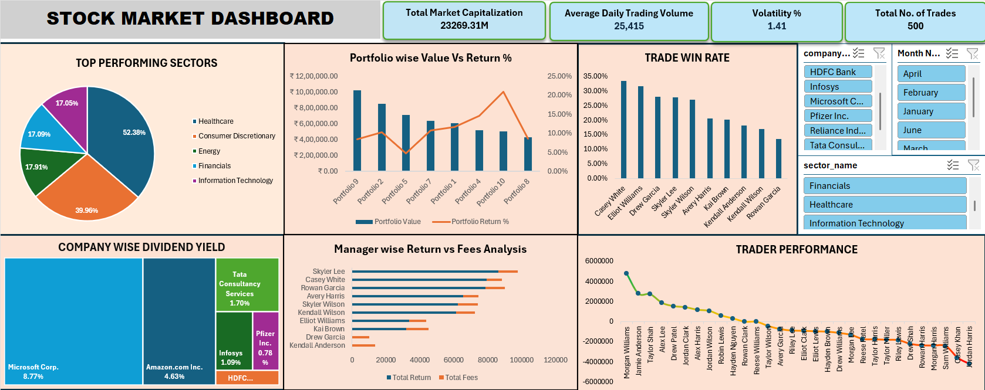
Excel Dashboard

Slide 6
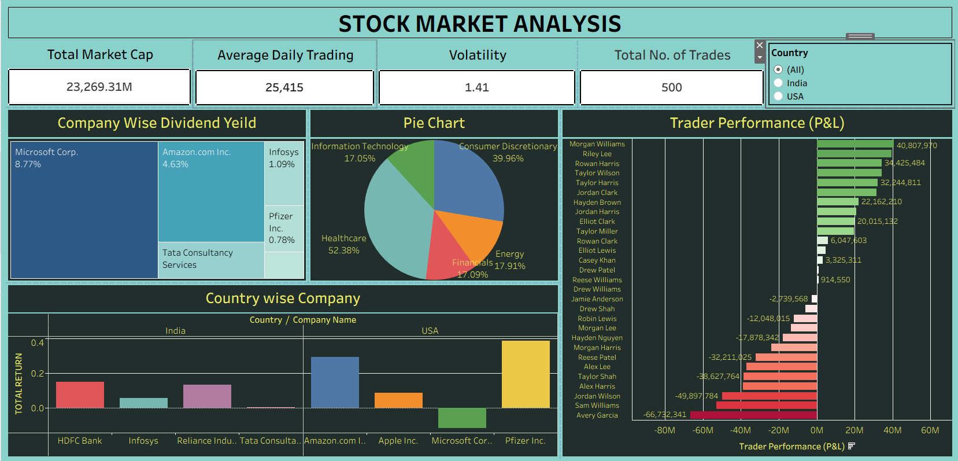
Tableau Dashboard

Slide 7
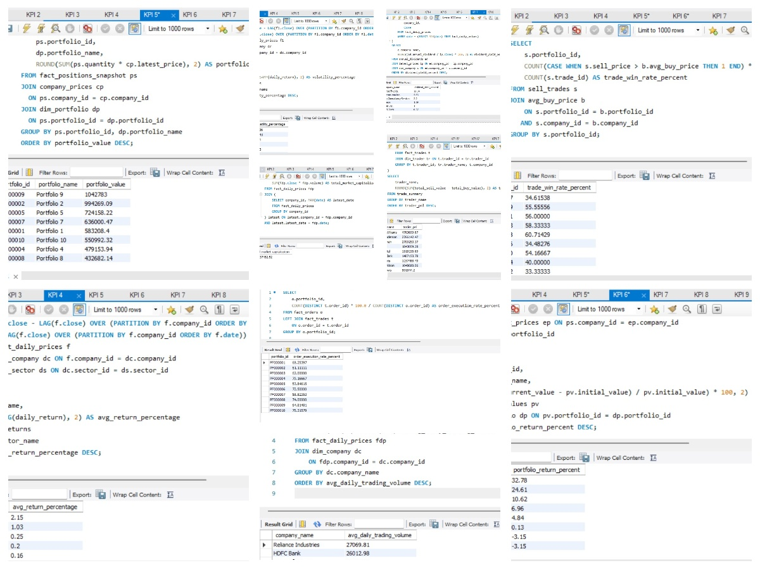
SQL Queries

Slide 8
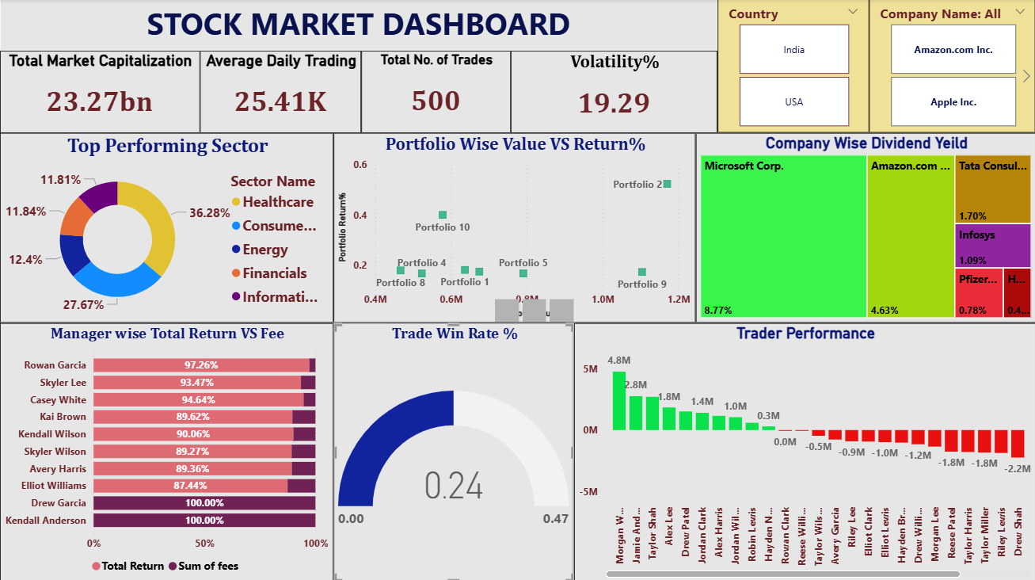
Power BI Dashboard
Power BI

Slide 9
Business Insights
The project uncovered strong market stability with key growth driven by Healthcare and Consumer Discretionary sectors.
Top-performing portfolios and traders achieved superior returns through efficient capital allocation and strategy execution.
Overall, it enabled data-driven investment insights and built a scalable analytics framework using SQL, Excel, Power BI, and Tableau.
Challenges
The project faced challenges in data integration and relationship building due to duplicate and inconsistent records across multiple fact tables.
Ensuring accurate KPI calculations like market capitalization and volatility required deep data validation.
Optimizing large datasets for smooth performance in Power BI and Tableau also demanded careful modelling and query tuning.
Future Recommendations
The client should reallocate investments toward high-performing sectors like Healthcare and Consumer Discretionary to maximize returns.
Implementing AI-driven portfolio optimization and automated trading can enhance profit and reduce risk.
Optimizing management fees and expanding into global markets will further increase overall revenue and portfolio efficiency.

Slide 10
THANK YOU

